Slide 1
Lecture 10: Sequential File Access
Dr. Tsung-Wei Huang
Department of Electrical and Computer Engineering
University of Utah, Salt Lake City, UT
Notes:
Morning everyone
Today we are looking into control flow in C++.

Slide 2
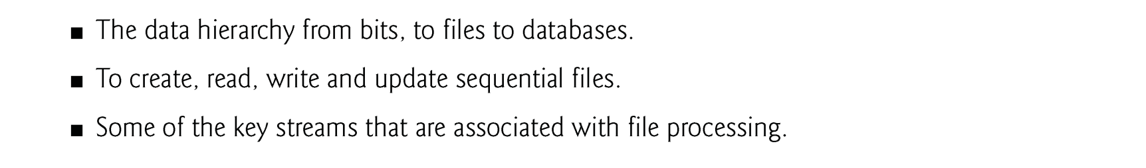
Learning Objective

Slide 3
Introduction
Storage of data in memory is temporary.
Files are used for data persistence—permanent retention of data.
Computers store files on secondary storage devices, such as hard disks, CDs, DVDs, flash drives and tapes.
In this chapter, we explain how to build C++ programs that create, update and process sequential files.

Slide 4
Data Hierarchy
Ultimately, all data items that digital computers process are reduced to combinations of zeros and ones.
The smallest data item that computers support is called a bit
Each data item, or bit, can assume either the value 0 or the value 1.
The decimal digits (0–9), letters (A–Z and a–z) and special symbols (e.g., $, @, %, &, *, …) are referred to as characters.
People create programs and data items with characters.
Every character in a computer’s character set is represented as a pattern of 1s and 0s.
Computers manipulate and process these characters as patterns of bits.
Bytes are composed of eight bits.

Slide 5
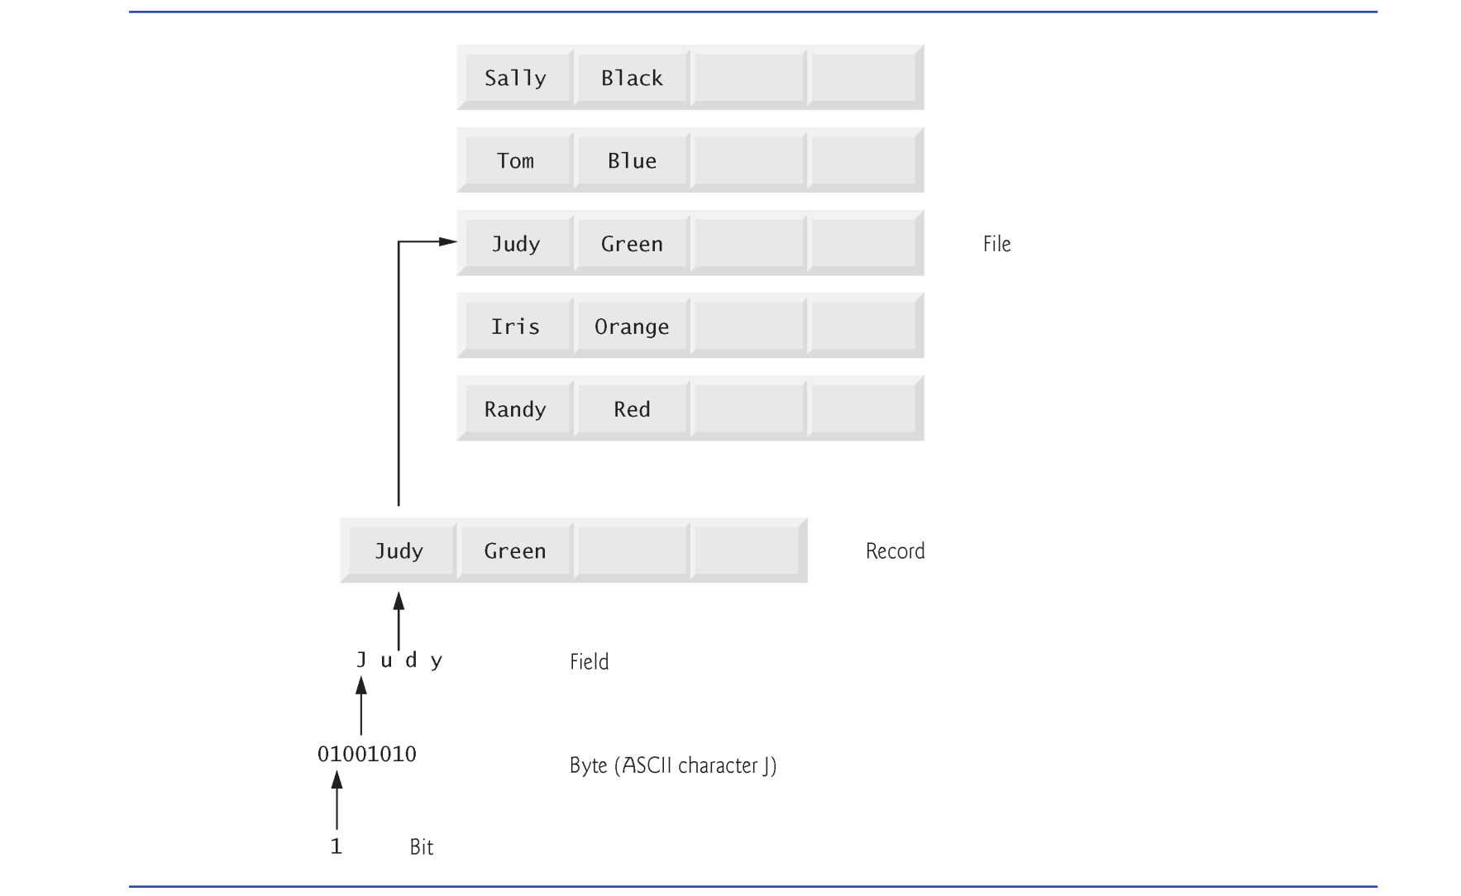
Data Hierarchy

Slide 6
File and Stream
C++ views each file as a sequence of bytes.
Each file ends either with an end-of-file marker or at a specific byte number recorded in operating.
When a file is opened, an object is created, and a stream is associated with the object.
The streams associated with these objects provide communication channels between a program and a particular file or device.

Slide 7
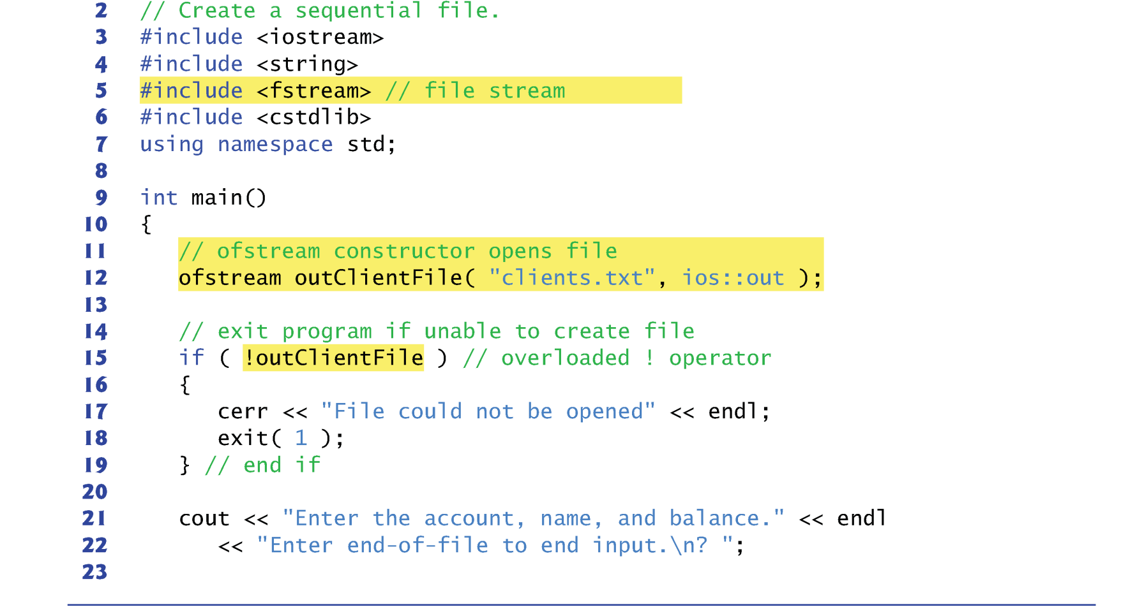
Creating a Sequential File

Slide 8
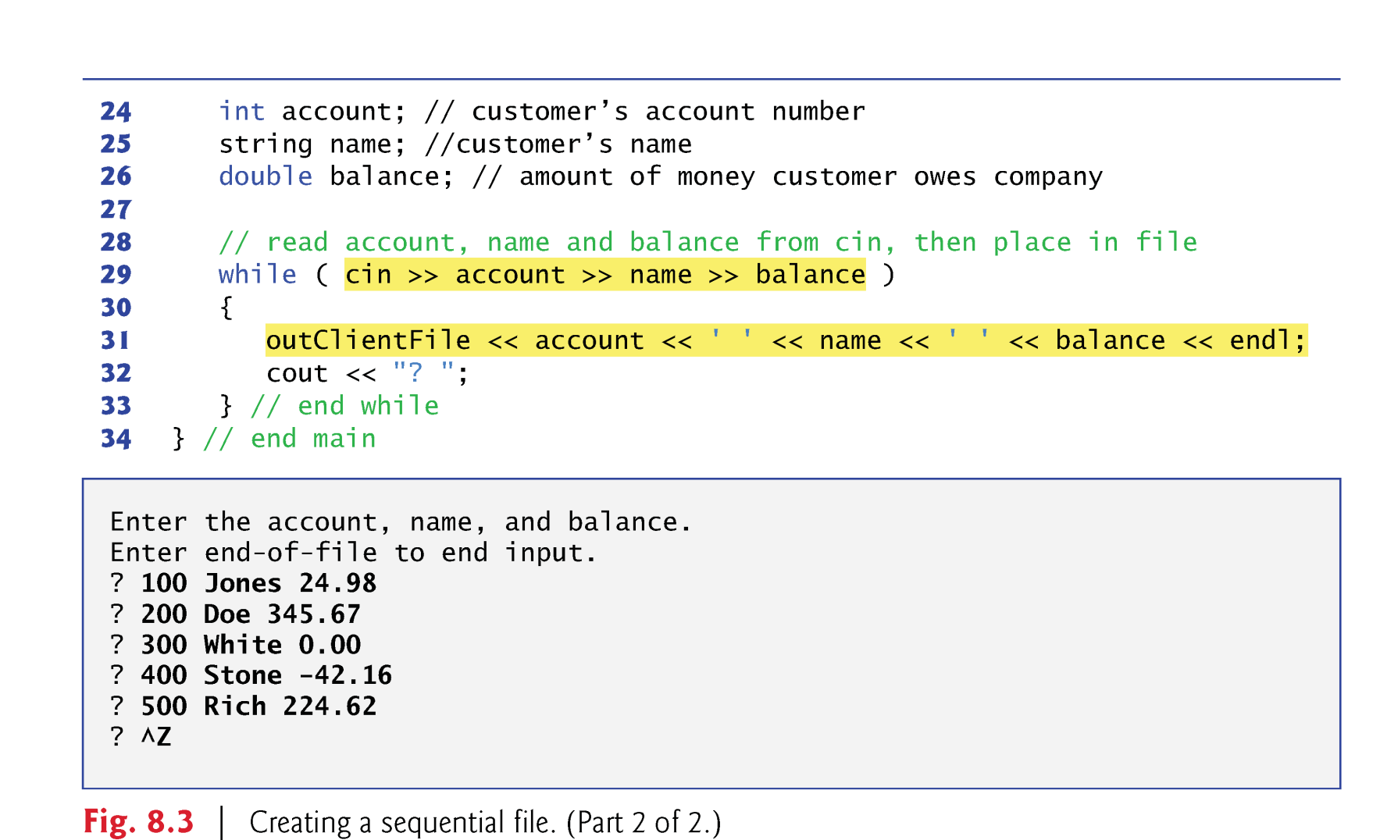
Creating a Sequential File

Slide 9
Creating a Sequential File
In the previous example, the file is to be opened for output, so an ofstream object is created.
This establishes a “line of communication” with the file.
By default, ofstream objects are opened for output.
Two arguments are passed to the object’s constructor—the filename and the file-open mode (line 12).
For an ofstream object, the file-open mode can be either
ios::out to output data to a file, or
ios::app to append data to the end of a file
If the specified file does not yet exist, then the ofstream object creates the file, using that filename.
Existing files opened with mode ios::out are truncated
All data in the file is discarded without warning.

Slide 10
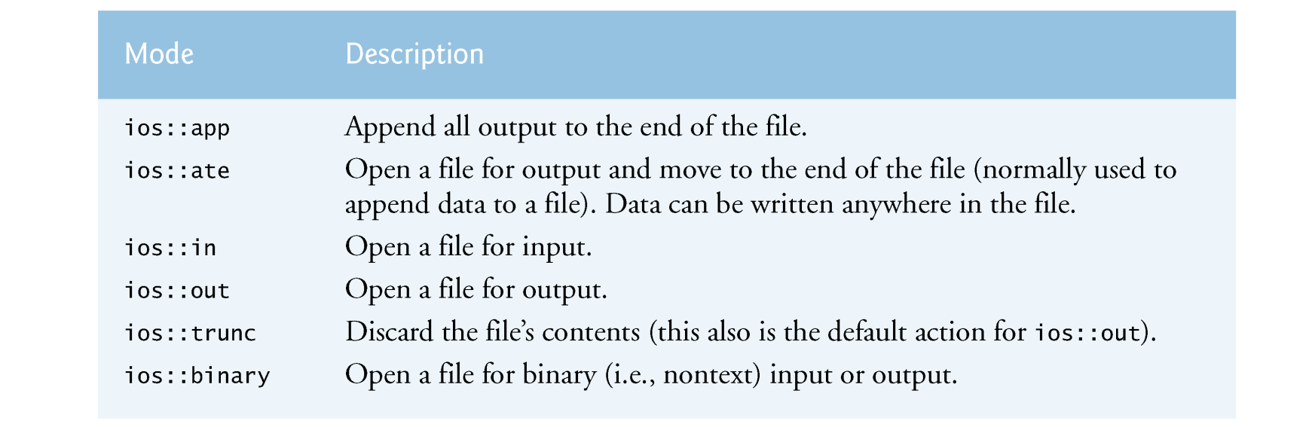
Modes

Slide 11
Creating a Sequential File
An ofstream object can be created without opening a specific file—a file can be attached to the object later.
For example, the statement
ofstream outClientFile;
creates an ofstream object named outClientFile.
The ofstream member function open opens a file and attaches it to an existing ofstream object as follows:
outClientFile.open("clients.txt", ios::out);

Slide 12
Creating a Sequential File
After creating an ofstream object, the program tests whether the open operation was successful before using it.
The condition in the if statement in lines 15–19 returns true if the open operation failed.
Some possible errors are
attempting to open a nonexistent file for reading,
attempting to open a file for reading or writing without permission,
opening a file for writing when no disk space is available.
Function exit terminates a program.
The argument to exit is returned to the environment from which the program was invoked. (0: normally, others: error)
The calling environment (most likely the operating system) uses the value returned by exit to respond appropriately to the error.

Slide 13
Reading a Sequential File
Files store data so it may be retrieved for processing when needed.
The next example reads records from the clients.txt file and displays the contents of these records.
Creating an ifstream object opens a file for input.
It can receive the filename and the file open mode as arguments.
Line 15 creates an ifstream object called inClientFile and associates it with the clients.txt file.
The arguments in parentheses are passed to the ifstream constructor function, which opens the file and establishes a “line of communication” with the file.

Slide 14
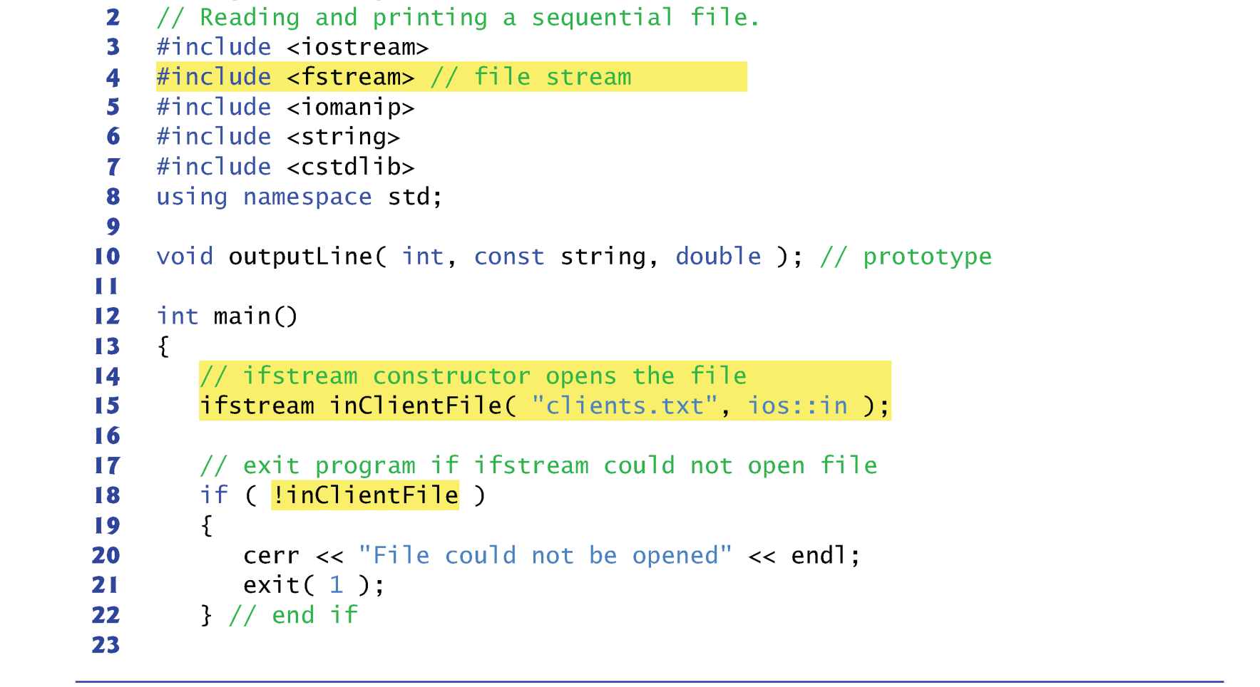
Reading a Sequential File

Slide 15
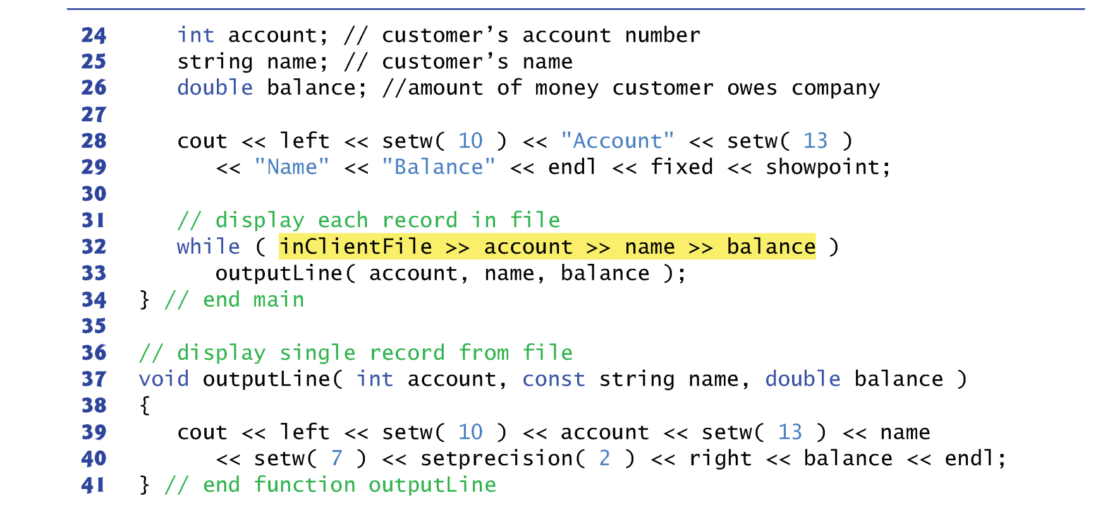
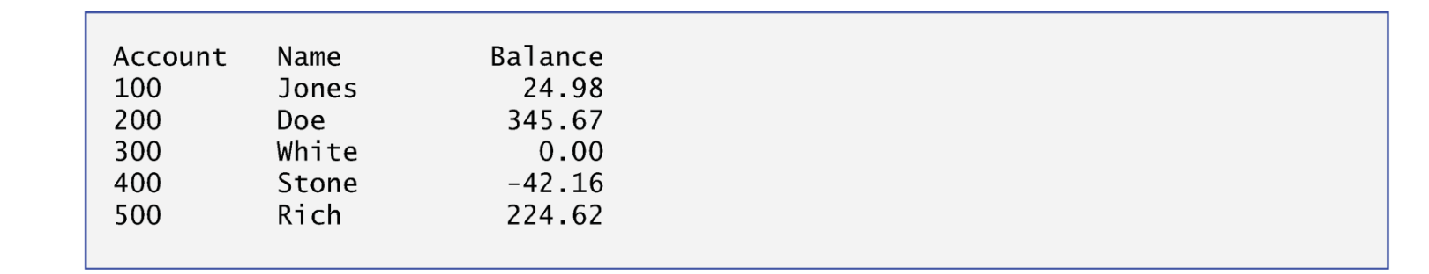
Reading a Sequential File

Slide 16
Reading a Sequential File
Objects of class ifstream are opened for input by default, so we could use the statement
ifstream inClientFile( "clients.txt" );
An ifstream object can also be created without opening a specific file
A file can be attached to it later.
Each time line 32 executes, it reads another record from the file into the variables account, name and balance.
Similar to using cin, but replace cin by inClientFile.
When the end of file has been reached, the while condition returns false and terminates the while statement and the program.

Slide 17
Reading a Sequential File
To retrieve data sequentially from a file, programs normally start reading from the beginning of the file and read all the data consecutively until the desired data is found.
It might be necessary to process the file sequentially several times (from the beginning of the file) during program execution.
Both istream and ostream provide member functions for repositioning the file-position pointer (the byte number of the next byte in the file to be read or written).
seekg (“ seek get”) for istream
seekp (“ seek put”) for ostream

Slide 18
Example
Some examples of positioning the “get” file-position pointer are
// position to the nth byte of fileObject (assumes ios::beg) fileObject.seekg( n );
// position n bytes forward in fileObject fileObject.seekg( n, ios::cur );
// position n bytes back from end of fileObject fileObject.seekg( n, ios::end );
// position at end of fileObject fileObject.seekg( 0, ios::end );
The same operations can be performed using ostream member function seekp.

Slide 19
Summary
Creating a file using ofstream
Reading a file using ifstream

